Slide 1

ADVANCED ANALYTICS
Prof. Qasim ALi

Slide 2

Team Members
Group Name - PHNJK
Name | Student_ID
Pratik Domadiya | 500199494
Hani Desai | 500195336
Nishi Agrawal | 500199806
Jaydeep Bhalala | 500198056
Keval Padsala | 500199506

Slide 3
About the Data set
This data set is about Uber Technologies Inc. which is an American multinational transportation network company based in San Francisco.
Our aim is to draw insights to enable growth in the market.
To draw the insights we have used libraries such as Numpy, Pandas, Matplotlib, Seaborn, etc.

Slide 4
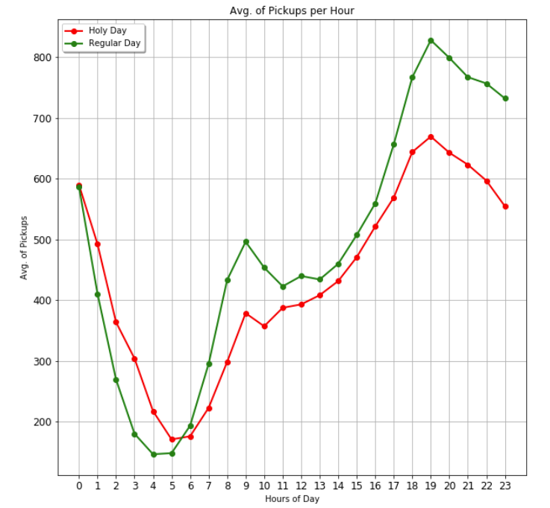
Graphs
This graph shows the Average pickups per hour.
It is seen that highest pickup is at night for holidays in comparison to the regular day.

Slide 5
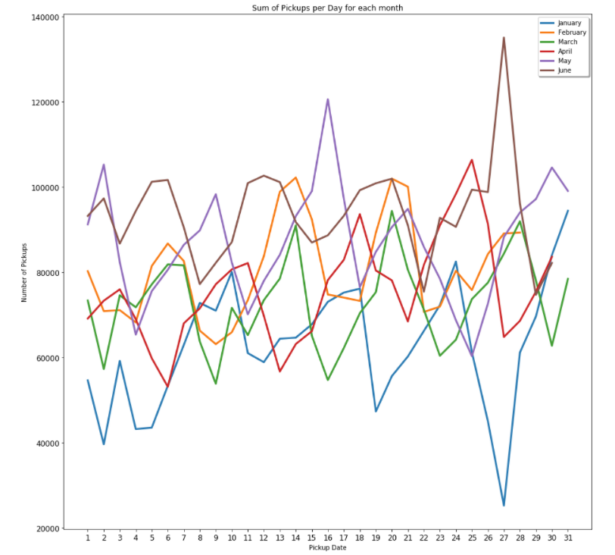
The graph depicts the pickups according to the month
There are sudden spikes in pickups on certain holidays and mostly saturdays in the month.

Slide 6
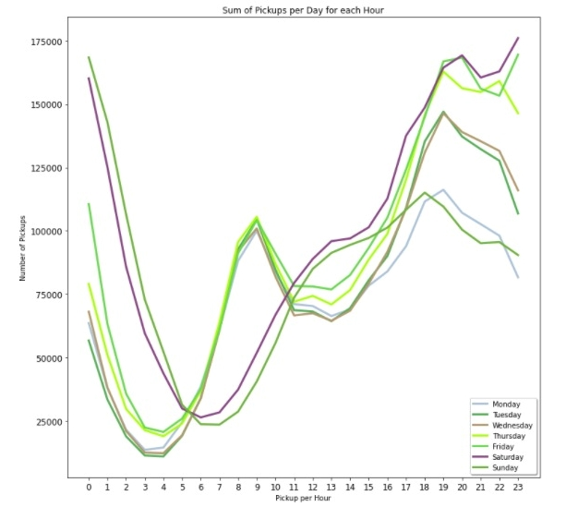
Depicts the weekly pickup hour wise.
Friday and Saturday nights have higher pickup than others days of the week

Slide 7
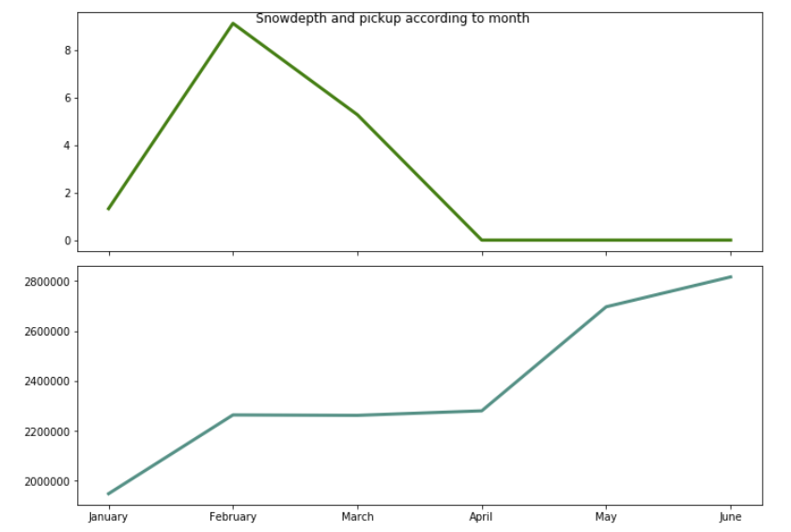
The graph compares the amount of snow in that month and how that affects the pickups
the month of January shows highest snow hence the pickups reduce and from February to April remains constant

Slide 8
Recommendation
Increase the fare price on specific holiday like new year eve and on Friday & Saturday nights a so on. So company will may get high profit. Another thing company can provides the best rate to the uber driver on that day so more uber drive are available meaning more uber rides are available to customers resulting high profits because I got that company needs to focus on few regions like... 'EWR' and 'Staten Island' which has very less Uber driver.

Slide 9
TEAM CONTRIBUTION
Student Name | Contribution
Pratik Domadiya | Tableau Insights, Python
Hani Desai | Presentation, Python
Nishi Agrawal | Python, Presentation
Jaydeep Bhalala | Presentation
Keval Padsala | Tableau Insights, Python

Slide 10
Thank You.

